Slide 1
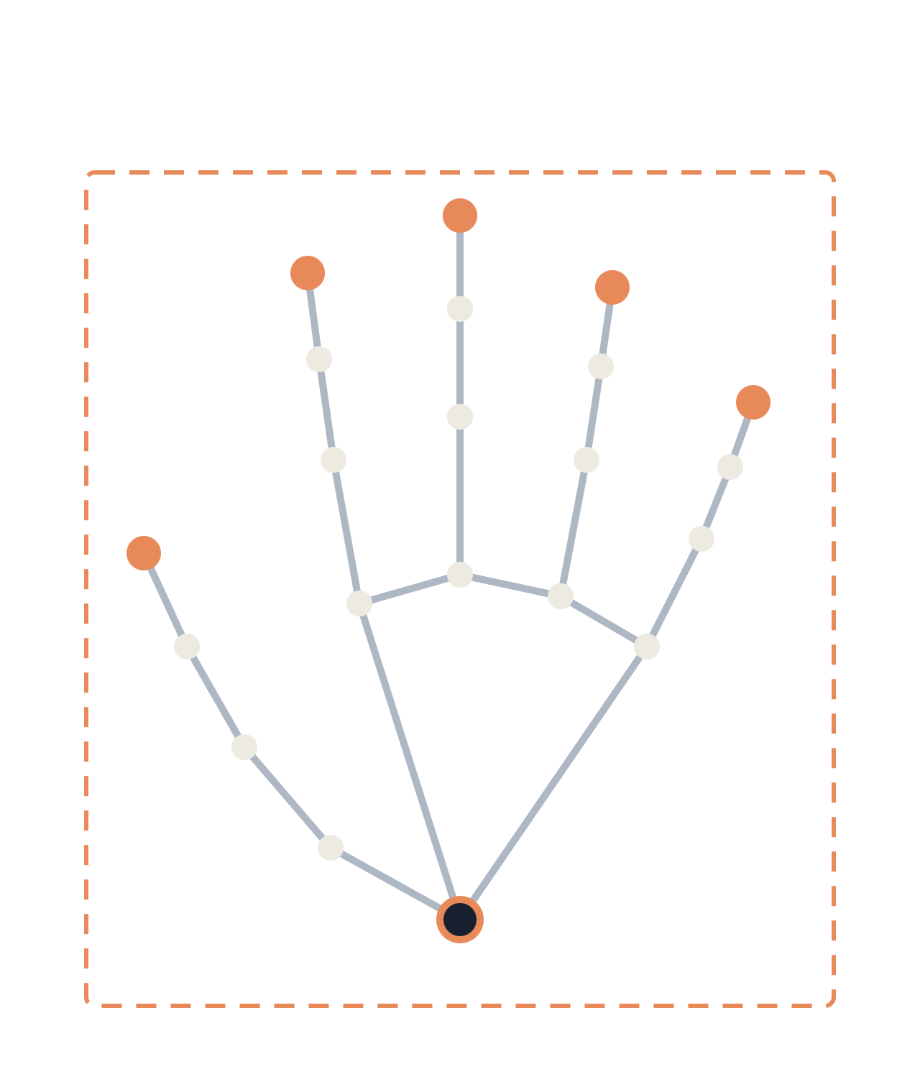
ISL-Lens
KTU B.TECH · FINAL REVIEW
A browser prototype for isolated Indian Sign Language recognition and two-way communication
PRESENTED BY
GUIDE
INSTITUTION
Aevlin Prince
Dr. Indu John
Dept. of CSE
Amal Jyothi College of Engineering
Notes:
Good morning. I am Aevlin Prince from the Department of Computer Science and Engineering at Amal Jyothi College of Engineering (Autonomous), presenting ISL-Lens under the guidance of Dr. Indu John. This is a browser-based prototype for isolated ISL sign recognition and communication support. Its offline clip benchmark is preliminary; live webcam accuracy has not yet been measured.

Slide 2

Introduction
BACKGROUND
ISL-Lens is a web application that recognizes supported Indian Sign Language signs from a webcam and supports two-way communication between signing and speaking users.
Signing user
ISL-Lens
Speaking user
SIGN → SPEECH
Webcam video
Landmarks, model, UNKNOWN gate
Transcript and text-to-speech
SPEECH → TEXT
Speaking user
Speech recognition
Signing user
Microphone
Speech converted to text
Text in the conversation view
ISL-Lens · Aevlin Prince · Guide: Dr. Indu John
02 / 18
Notes:
The sign-to-speech path captures webcam video, extracts landmarks in the browser, classifies a window, displays the gloss or UNKNOWN and can speak the result. The separate reverse path uses browser speech recognition to add text to the conversation. These are communication aids for a limited isolated-sign vocabulary; they are not a general ISL interpreter.

Slide 3
Problem Statement
BACKGROUND
A recognizer that maps every gesture to its nearest known sign will be confidently wrong.
01
02
Forced prediction
Inflated accuracy
Unsupported, incomplete or transition gestures still receive a known label.
The same signer, recording or augmented copy can leak across train and test splits.
03
04
Lab-to-webcam gap
No sentence labels
DESIGN RESPONSE
Lighting, background, distance and landmark dropouts change real-world behavior.
Isolated sign labels cannot supervise or evaluate natural English sentences.
Return UNKNOWN when unsure, and report only measured results.
ISL-Lens · Aevlin Prince · Guide: Dr. Indu John
03 / 18
Notes:
The motivating problem is that closed-set prediction can confidently map unsupported gestures to a known label. Other risks are small clip counts, possible source and signer variation, training-to-browser feature mismatch, and the absence of a live-user evaluation. The confidence threshold reduces some low-score outputs but is not a guarantee.

Slide 4
Objectives
BACKGROUND
01
Audit candidate datasets and build a manifest with leakage-free splits
02
Define one canonical preprocessing used by both training and live inference
03
Compare temporal models fairly on the same splits and protocol
04
Return UNKNOWN for unsupported gestures using validation-selected thresholds
05
Deliver live webcam recognition with transcript, text-to-speech and speech-to-text
06
Report dataset and real-world webcam results separately, using measured metrics only
ISL-Lens · Aevlin Prince · Guide: Dr. Indu John
04 / 18
Notes:
Project objectives were to audit data, build a reproducible landmark baseline, implement a browser demo with UNKNOWN handling and communication features, and evaluate it. The final review distinguishes delivered prototype features from still-pending data, model-comparison, signer-independent, live-webcam and user-study work.

Slide 5
Literature Survey
SURVEY
Work | Contribution | Role in ISL-Lens
MediaPipe Hands (Zhang et al., 2020) | Real-time hand landmark tracking from video | Used for landmark extraction; it does not validate sign classification [1]
LSTM (Hochreiter & Schmidhuber, 1997) | Models dependencies across a sequence | Related work; not implemented in this prototype [2]
Transformer (Vaswani et al., 2017) | Attention-based sequence modeling | Related work; not implemented [3]
ST-GCN (Yan et al., 2018) | Graph convolution over skeleton joints and time | Related work; not implemented [4]
INCLUDE (Sridhar et al., 2020) | Large isolated Indian Sign Language dataset | Relevant benchmark literature; current run uses a separate 40-word aggregate corpus [5]
Literature informs candidate methods; only the landmark + logistic-regression baseline is implemented here.
ISL-Lens · Aevlin Prince · Guide: Dr. Indu John
05 / 18
Notes:
The literature survey identifies established building blocks and candidate model families. MediaPipe Hands is used for hand landmark extraction. LSTM, Transformer and ST-GCN are related approaches only; this prototype has not implemented or compared them. INCLUDE is relevant ISL dataset literature, but this run uses the separate isl-isolated-40words aggregate corpus, not INCLUDE. Sources: [1] Zhang et al., arXiv:2006.10214 (2020); [2] Hochreiter & Schmidhuber (1997); [3] Vaswani et al. (2017); [4] Yan et al. (2018); [5] Sridhar et al., ACM Multimedia (2020).

Slide 6

Research Gaps and Design Response
SURVEY
GAP 1
Closed-set classifiers must always output a known sign
Confidence cutoff can return UNKNOWN
Fixed 0.35 threshold; open-set performance not measured
GAP 2
Reported accuracy can be inflated by split leakage
Random clip-level holdout
No signer-independent result is available
GAP 3
Isolated sign labels cannot supervise full sentences
Rule-based gloss formatter
Sentence quality is not trained or measured
GAP 4
Feature and model choices are rarely justified
One logistic-regression baseline
No controlled temporal-model comparison yet
ISL-Lens · Aevlin Prince · Guide: Dr. Indu John
06 / 18
Notes:
The system includes a confidence-based UNKNOWN state, but the current threshold is a fixed 0.35 and has not been validated on a representative unknown-sign set. The reported split is random and clip-level rather than signer-independent. Sentence output is deterministic gloss formatting, not a trained ISL translation model. Only one classifier family has been evaluated.

Slide 7


Implemented Recognition and Communication Flow
METHOD
01
02
03
04
05
Camera
Landmarks
Features
Window
Classifier
Browser video frames
MediaPipe Hands + Pose
Python training / JS live paths
32 sampled frames per clip
Scaled multinomial logistic regression
10
09
08
07
06
Speech output
Sentence text
Gloss output
Peak filter
Confidence gate
Browser text-to-speech
Gloss rules
Known label or no clear sign
Select and deduplicate windows
Score below 0.35 → UNKNOWN
SEPARATE PATH · SPEECH TO TEXT
Microphone
Browser speech recognition
Transcript
Conversation view
ISL-Lens · Aevlin Prince · Guide: Dr. Indu John
07 / 18
Notes:
The implemented pipeline starts from webcam frames and browser MediaPipe landmarks. The deployed model uses a 32-frame, 828-value summary and a multinomial logistic-regression classifier. A maximum-score cutoff can yield UNKNOWN. Sentence capture uses multiple temporal windows and peak de-duplication, then applies deterministic gloss-to-English rules; it is not a trained sentence translation model. Browser speech recognition handles the reverse speech-to-text path. A material limitation is that training and browser body-region preprocessing are not equivalent; see the feature slide.

Slide 8
Implementation Status
METHOD
GATE 00 · COMPLETE
GATE 01 · PARTIAL
GATE 02 · PARTIAL
GATE 03 · IMPLEMENTED
Specification
Dataset audit
Preprocessing
Baseline model
Scope documented
642 clips · 40-word aggregate
32 × 138 values → 828 features
Logistic-regression baseline
GATE 04 · PENDING
GATE 05 · BASELINE
GATE 06 · PROTOTYPE
GATE 07 · IMPLEMENTED
Model bake-off
Open-set rejection
Webcam inference
Web application
Model comparison pending
0.35 cutoff; OOD untested
Live accuracy not measured
UI, transcript and vocabulary
GATE 08 · HEURISTIC
GATE 09 · IMPLEMENTED
GATE 10 · IMPLEMENTED
GATE 11 · PARTIAL
Sentence generation
Two-way communication
Practice and export
Final evaluation
Gloss rules; no trained translation
Browser speech input and output
Practice mode and PDF export
Clip holdout; live study pending
Current completion is a working prototype and clip-level baseline; signer-independent and live-user evidence remain open.
ISL-Lens · Aevlin Prince · Guide: Dr. Indu John
08 / 18
Notes:
This is the actual status at final review. A prototype exists, and the offline clip baseline has a held-out estimate. The project has not completed a controlled temporal-model comparison, signer-independent evaluation, unknown-sign evaluation, webcam accuracy study or usability survey. Training and browser preprocessing parity remains an open engineering task.

Slide 9
Implementation: Features and Preprocessing
BUILD
Feature block | Current baseline
Hand landmarks | 126 values/frame
Wrist/context | 12 values/frame
Frame vector | 138 values/frame
Temporal sample | 32 frames per clip
Summary vector | 6 statistics → 828 values
Training clips · Python
Live webcam · Browser
CURRENT PREPROCESSING GAP
32-frame feature summary
138 values/frame → 828 summary values
Training and browser feature paths are not yet equivalent.
OpenCV + MediaPipe Hands
MediaPipe Hands + Pose
Training/browser body-region logic differs; parity tests needed
ISL-Lens · Aevlin Prince · Guide: Dr. Indu John
09 / 18
Notes:
Training samples 32 frames per clip. Each frame has 126 hand-coordinate values and 12 wrist/context values; six summary statistics produce 828 model inputs. The Python training path uses OpenCV and MediaPipe Hands. Browser inference uses JavaScript MediaPipe Hands and Pose. Python body-region features use fixed vertical thresholds, while browser logic uses pose landmarks, so the two paths are not mathematically equivalent. Unifying and testing these features is a priority before claiming webcam accuracy. Source: src/preprocessing/landmark_features.py and app/static/js/app.js.

Slide 10
Implementation: Model and Evaluation Setup
BUILD
Implemented element | Current configuration
Classifier | Multinomial logistic regression
Scaling | StandardScaler
Class weighting | Balanced
Input | 828 features from 32 sampled frames
Training labels | 48 labels in the fitted model
Evaluation labels | 36 labels represented in held-out clips
Comparison | One model; no controlled bake-off
HELD-OUT PROTOCOL
Stratified 80/20 split · seed 42
129 held-out clips
User examples train-only
MODEL ARTIFACT
Logistic regression + StandardScaler
Balanced class weights
Fixed threshold: 0.35
No live / signer-held-out result
The current result is a single baseline, not a model bake-off.
ISL-Lens · Aevlin Prince · Guide: Dr. Indu John
10 / 18
Notes:
The model is a scikit-learn Pipeline with StandardScaler and multinomial LogisticRegression (class_weight=balanced, solver=lbfgs, C=1.0, max_iter=2500, seed 42). Features are 828-dimensional summaries of 32 sampled frames. The split uses a stratified random 20% holdout for classes with at least two clips; singleton classes remain training-only. There are 129 held-out base clips across 36 represented labels, while the fitted model has 48 labels including additional training/user correction labels. This is not a signer-independent split and no competing model family was evaluated. Source: scripts/train_calibrated_model.py and reports/experiments/isl40_landmark_logreg_report.json.

Slide 11
Rejection and Sequence Logic
BUILD
CURRENT REJECTION POLICY
LIMITS OF UNKNOWN
Softmax max score ≥ 0.35
Low-score or empty windows can be rejected
No explicit unknown-sign training set
False accept / reject rates not measured
Confidence is not a guarantee of correctness
Scores below the cutoff return UNKNOWN; open-set error rates are unmeasured.
SENTENCE CAPTURE (SEPARATE MODE)
Sliding windows
Select high-score peaks
De-duplicate signs
Apply gloss rules
HELLO HELLO HELLO
HELLO · UNKNOWN · GO
Adjacent duplicates are collapsed
Output is heuristic; translation accuracy is unmeasured
ISL-Lens · Aevlin Prince · Guide: Dr. Indu John
11 / 18
Notes:
The deployed classifier uses the largest softmax score with a fixed threshold of 0.35. This is a confidence heuristic, not a validated open-set detector: the report contains no dedicated unknown-sign test set, false-accept rate, false-reject rate, AUROC or AUPR. Sentence capture is a separate browser mode that scans several window sizes, selects non-overlapping high-score peaks and removes consecutive duplicate glosses. English output comes from deterministic phrase rules rather than a trained translation model. Source: app/static/js/app.js and the model JSON configuration.

Slide 12
Implementation: Web Application
BUILD
ISL-LENS
LOCAL WEB APP
PROJECT STRUCTURE
WEBCAM + LANDMARK OVERLAY
MODEL OUTPUT
src/preprocessing/ · feature code
scripts/ · training and launch
app/backend/ · Python server
app/templates/ · app/static/
configs/ · data/corrections/
reports/experiments/
Gloss or UNKNOWN
RAW GLOSS TRANSCRIPT
Recognized sign sequence
Inside usable region
RULE-BASED TEXT
Gloss formatter output
DESIGN RULES
Local Python server + browser model
Speech, practice, tutor and PDF export
Corrections saved locally
MICROPHONE · SPEECH RECOGNITION
Spoken message appears as text
Speech out
Vocabulary
Practice
PDF export
A product-flow sketch; browser performance has not been benchmarked.
ISL-Lens · Aevlin Prince · Guide: Dr. Indu John
12 / 18
Notes:
This slide is a product-flow sketch rather than an application screenshot. The local app is served by a Python standard-library ThreadingHTTPServer on localhost. The browser loads the JSON logistic-regression model and performs inference; speech recognition and text-to-speech use browser APIs. The interface includes a camera/landmark overlay, current gloss and transcript, vocabulary/tutor, practice, user correction/retraining, conversation export and heuristic sentence mode. Corrections are stored locally. There is no authentication or database. External browser libraries/media assets may require network access. Source: scripts/run_local.py, app/backend/server.py, app/templates/index.html and app/static/js/app.js.

Slide 13
Results: Held-out Clip Benchmark
RESULTS
Metric | Measured | Context
Top-1 | 93.0% · 120/129 | 20% clip holdout
Top-3 | 97.7% · 126/129 | Same test clips
Macro F1 | 91.2% | 36 test labels
Weighted F1 | 92.5% | Support weighted
Holdout | 129 / 642 clips | Stratified · seed 42
Webcam accuracy | Not measured | No live study
WHAT THE REPORT SHOWS
120 of 129 clips top-1 correct
126 of 129 contain the true label in top-3
Macro F1: 91.2%
Weighted F1: 92.5%
WHAT IT DOES NOT SHOW
Signer-independent accuracy
Live webcam accuracy
Unknown-sign rejection rate
Latency, SUS or user-study results
Preliminary clip-level estimate; not signer-independent or live accuracy.
ISL-Lens · Aevlin Prince · Guide: Dr. Indu John
13 / 18
Notes:
Measured report values: 642 base corpus clips; a stratified random 20% holdout with seed 42; 129 held-out clips; top-1 120/129 = 93.0%; top-3 126/129 = 97.7%; macro F1 91.2%; weighted F1 92.5%. Those 129 clips represent 36 labels; the fitted model has 48 classes after including training-side examples. One hundred user-taught examples were training-only and excluded from evaluation. This is a clip-level same-corpus held-out estimate, not signer-independent performance, live webcam accuracy, a population guarantee, or an open-set rejection score. The deployed artifact is refit on the full corpus and examples after benchmark evaluation; these metrics do not evaluate that refit model. Source: reports/experiments/isl40_landmark_logreg_report.json.

Slide 14
Webcam Evaluation Plan · Not Yet Run
RESULTS
Environment
Signer
Gesture
Lighting variation
N/R
Multiple signers
N/R
Partial signing
N/R
Background variation
N/R
Left and right hand
N/R
Transitions
N/R
Camera distance
N/R
Slow signing
N/R
Pauses
N/R
Hand position
N/R
Fast signing
N/R
Unsupported gestures
N/R
Clothing
N/R
Visually similar signs
N/R
HOW RESULTS ARE READ
No controlled webcam accuracy or usability study has been completed. Treat this as a proposed test matrix, not measured results.
ISL-Lens · Aevlin Prince · Guide: Dr. Indu John
14 / 18
Notes:
The environment, signer and gesture conditions shown are a test plan only; no counts or accuracy values have been collected. “N/R” means not run. A final evaluation should define participants and consent, repeated trials per condition, ground-truth labels, device/browser, lighting/background, and scoring for known and unknown signs. Report correct acceptance, false rejection, false acceptance, per-class recall, and latency separately. A SUS or accessibility/usability survey has also not been conducted.

Slide 15
Conclusions
CLOSE
01
A local browser prototype supports isolated-sign recognition and two-way communication.
GUIDING PRINCIPLES
Evidence before claims
02
The logistic-regression baseline scored 93.0% top-1 and 97.7% top-3 on 129 held-out clips.
UNKNOWN before a confident guess
03
This result does not establish signer-independent or live webcam accuracy.
Validate across signers and conditions
04
Sentence output is heuristic gloss formatting, not trained ISL translation.
Separate glossing from translation
Improve with measured data
ISL-Lens · Aevlin Prince · Guide: Dr. Indu John
15 / 18
Notes:
The main result is a working local prototype and a preliminary clip-level classifier estimate: 93.0% top-1, 97.7% top-3 on 129 held-out clips. It is not a live-webcam or signer-independent accuracy claim. The fixed confidence cutoff, small heterogeneous dataset, browser/training feature mismatch, and unmeasured user experience explain why the system can still show incorrect signs. The immediate next step is to unify features and collect controlled signer-held-out and webcam evaluation data.

Slide 16
Limitations and Risks
CLOSE
Limitation | Mitigation / next action
Small 40-word corpus; 642 clips and sparse labels | Audit sources, expand signer-balanced data and report class support
Random clip split; signer independence unknown | Create signer-held-out evaluation with verified signer IDs
Python and browser feature paths differ | Unify landmark/body-region features and add parity tests
0.35 confidence cutoff; no unknown test set | Collect known/unknown validation clips; tune and report FAR/FRR
No webcam or usability study | Run controlled webcam protocol and SUS/accessibility survey
Gloss-to-English rules are heuristic | Collect paired video/gloss/English data before translation claims
User corrections are locally stored; there is no authentication or account separation.
ISL-Lens · Aevlin Prince · Guide: Dr. Indu John
16 / 18
Notes:
The key limitations are evidence and data coverage rather than visual interface features. The 40-word corpus aggregates clips from multiple upstream sources; the run contains 642 clips. The held-out split is random by clip and has no signer-independent guarantee. Only 36 labels appear in the test set. Training and browser feature construction differ. UNKNOWN is based on a fixed 0.35 confidence cutoff with no dedicated unknown test set. No controlled webcam, latency, privacy, accessibility or SUS user study has been completed. Sentence English is generated by deterministic rules. User corrections are stored locally; this prototype has no authentication or account separation.

Slide 17

Future Scope
CLOSE
NEXT · DATA AND DEPLOYMENT
THEN · LANGUAGE
LATER · PLATFORM
Fix Python/browser preprocessing parity
Gather paired ISL video, gloss and English annotations
Calibrate UNKNOWN with test data
Only expand vocabulary when reliable labeled data is available.
Collect signer-balanced clips and establish a held-out-signer test
Train and evaluate sentence translation separately
Offline-capable browser inference
Review language output with fluent ISL users
Run webcam, latency and usability/SUS studies
Every new sign needs legitimate data, a vocabulary update, retraining and re-evaluation.
ISL-Lens · Aevlin Prince · Guide: Dr. Indu John
17 / 18
Notes:
Priority order: first make training and browser features equivalent; next gather more signer-balanced data and run a signer-held-out evaluation; then conduct a controlled webcam protocol and SUS/accessibility survey. Sentence translation requires paired video, gloss and English annotations plus review by fluent ISL users. Rejection thresholds need a validation set with known and unknown examples. Larger platform features such as WebRTC or federated learning are later work.

Slide 18
References
CLOSE
Q & A
[1] F. Zhang et al., “MediaPipe Hands: On-device Real-Time Hand Tracking,” arXiv:2006.10214, 2020.
Questions?
[2] S. Hochreiter and J. Schmidhuber, “Long Short-Term Memory,” Neural Computation, 1997.
Thank you for listening.
[3] A. Vaswani et al., “Attention Is All You Need,” NeurIPS, 2017.
[4] S. Yan, Y. Xiong and D. Lin, “Spatial Temporal Graph Convolutional Networks for Skeleton-Based Action Recognition,” AAAI, 2018.
[5] A. Sridhar et al., “INCLUDE: A Large Scale Dataset for Indian Sign Language Recognition,” ACM Multimedia, 2020.
[6] D. Hendrycks and K. Gimpel, “A Baseline for Detecting Misclassified and Out-of-Distribution Examples in Neural Networks,” ICLR, 2017.
[7] C. Guo et al., “On Calibration of Modern Neural Networks,” ICML, 2017.
[8] K. Lee et al., “A Simple Unified Framework for Detecting Out-of-Distribution Samples and Adversarial Attacks,” NeurIPS, 2018.
PRESENTED BY
[9] W. Liu et al., “Energy-based Out-of-distribution Detection,” NeurIPS, 2020.
Aevlin Prince
GUIDE
Dr. Indu John
ISL-Lens · Aevlin Prince · Guide: Dr. Indu John
18 / 18
Notes:
References [1] and [5] are the implemented landmark technology and related ISL dataset literature. References [2]–[4] are alternative sequence-model literature and were not implemented in this prototype. References [6]–[9] describe possible rejection/calibration approaches; this implementation uses a fixed softmax-score threshold and has not evaluated those alternatives. The current corpus report identifies isl-isolated-40words as an aggregate of upstream sources; see docs/GATE1_DATASET_AUDIT.md and the dataset card at https://huggingface.co/datasets/vidit031/isl-isolated-40words. KTU review requirements vary by scheme and department; confirm final section order and evaluation forms with the department.

